Slide 1

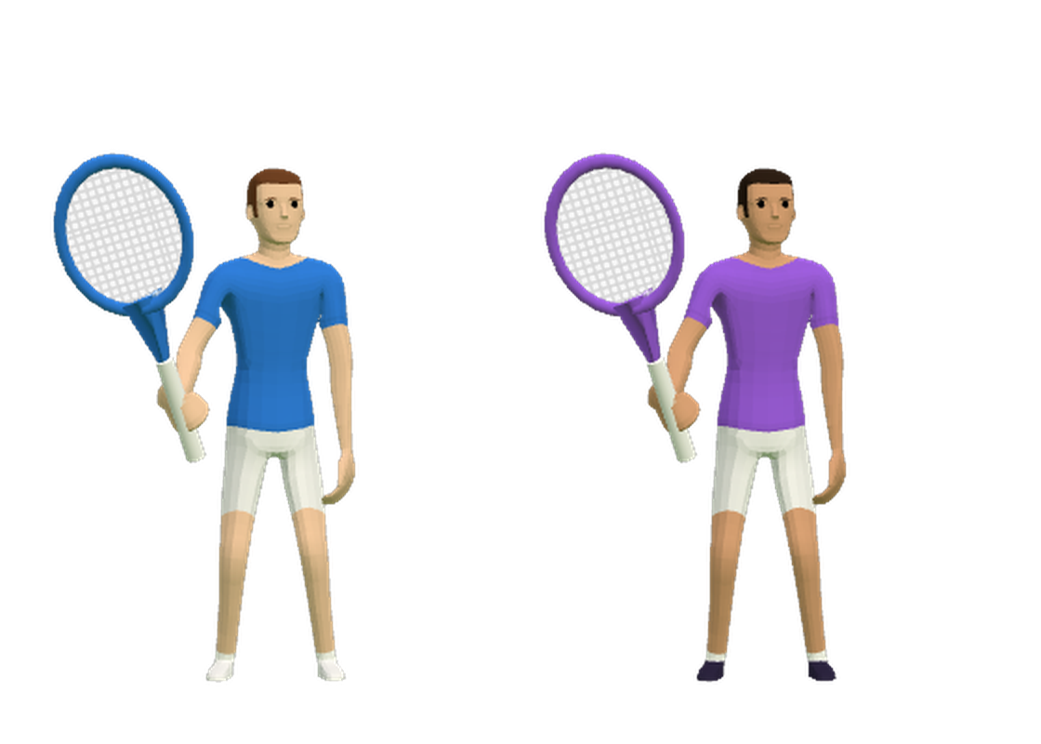
AirSports
Your phone is the racquet | Rahul Bajaj
Notes:
Hi, I'm Rahul. AirSports turns any screen into a sports console and your phone into the racquet. Keep the game open in another tab for the live demo.

Slide 2
Problem
Motion games are fun, but they are locked behind expensive hardware.
Kinect and the Wii have been discontinued, so most homes, hostels and colleges have nothing to play on.
Console sports need
Console
+
Motion controllers
+
Camera or sensor
+
TV
AirSports needs
A phone you already own
+
Any screen with a browser
Everyone already carries a smartphone and sits near a screen, but phone games are played alone, heads down.
Notes:
Ask the room: who has played Wii Sports? Who owns a Wii or Kinect today? That gap is the problem.

Slide 3
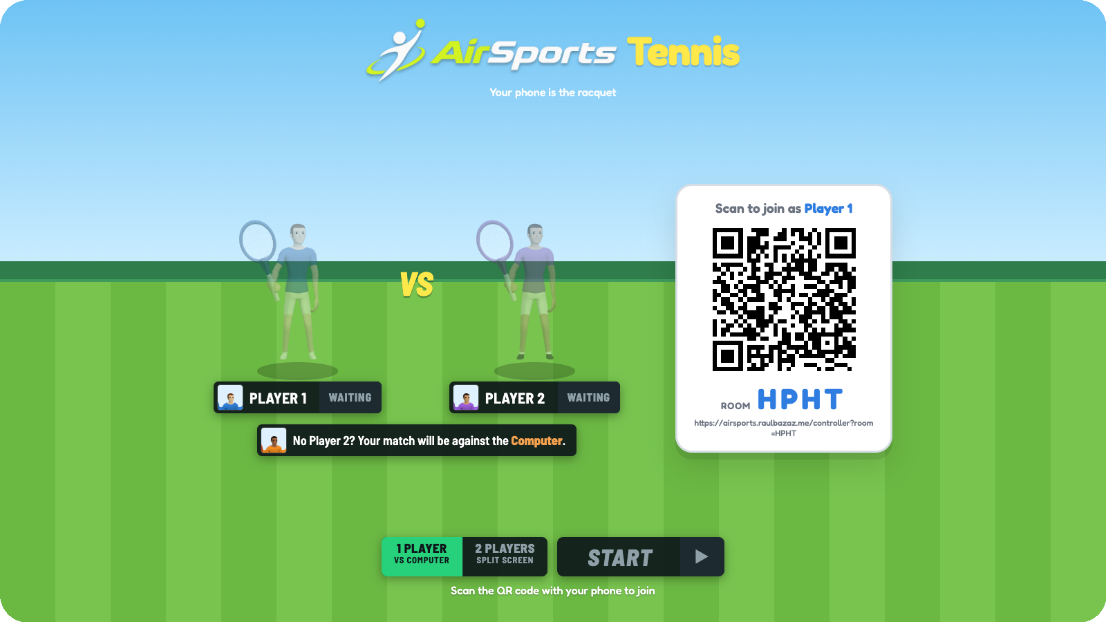
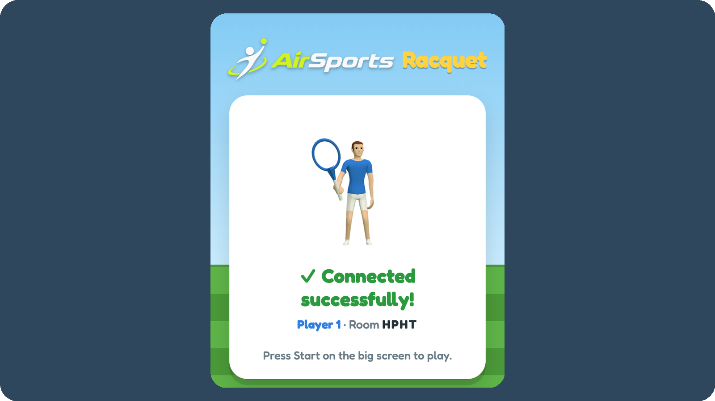
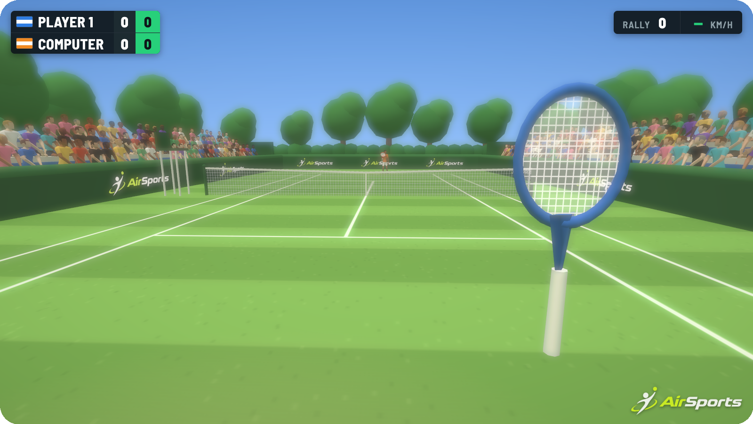
Solution
Any screen becomes the console. Any smartphone becomes the racquet.
1 Open on any screen
2 Scan the QR code
3 Swing to play
No app
No account
No console
Solo vs computer
2 players, split screen
Most phone-as-controller games turn the phone into a touch gamepad. AirSports reads your actual swing.
Notes:
The whole setup takes about ten seconds. This is the moment to show the QR code join live if you can.

Slide 4
Market Size
500M
gamers in India in 2025
Anyone with a phone and a screen is a potential player. We start with Indian colleges.
95%
of them play on mobile, so the controller is already in their pocket
Sources: Niko Partners, The Indian Games Market 2025; SkyQuest, Motion Sensing Games Market report
Notes:
500 million Indian gamers are already on their phones. We don't need to sell them hardware; we turn the phone they own into the controller.

Slide 5
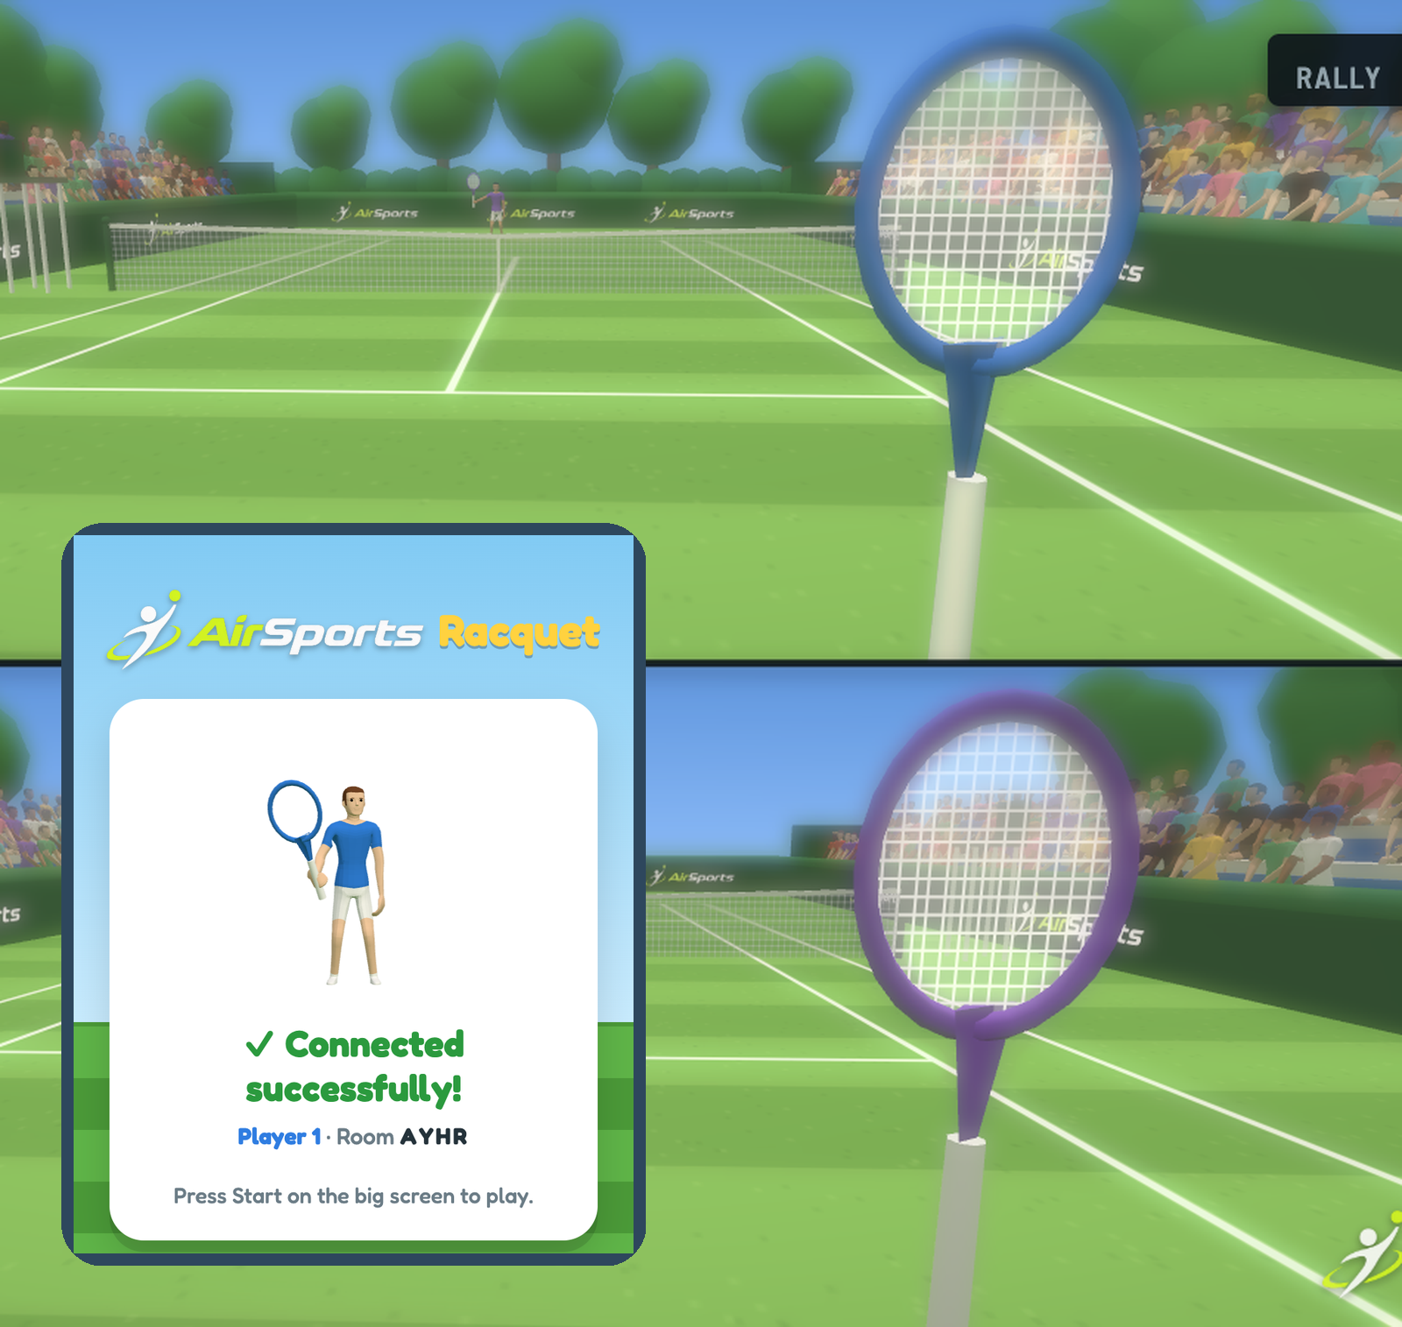

Product
A real tennis match, played with a real swing.
Swing harder to hit harder. Tilt the phone to angle the shot.
3D court
Live score
First-person view
Rally speed
Notes:
Left: the phone after scanning the QR code. Behind it: a two-player split-screen match on the TV.

Slide 6
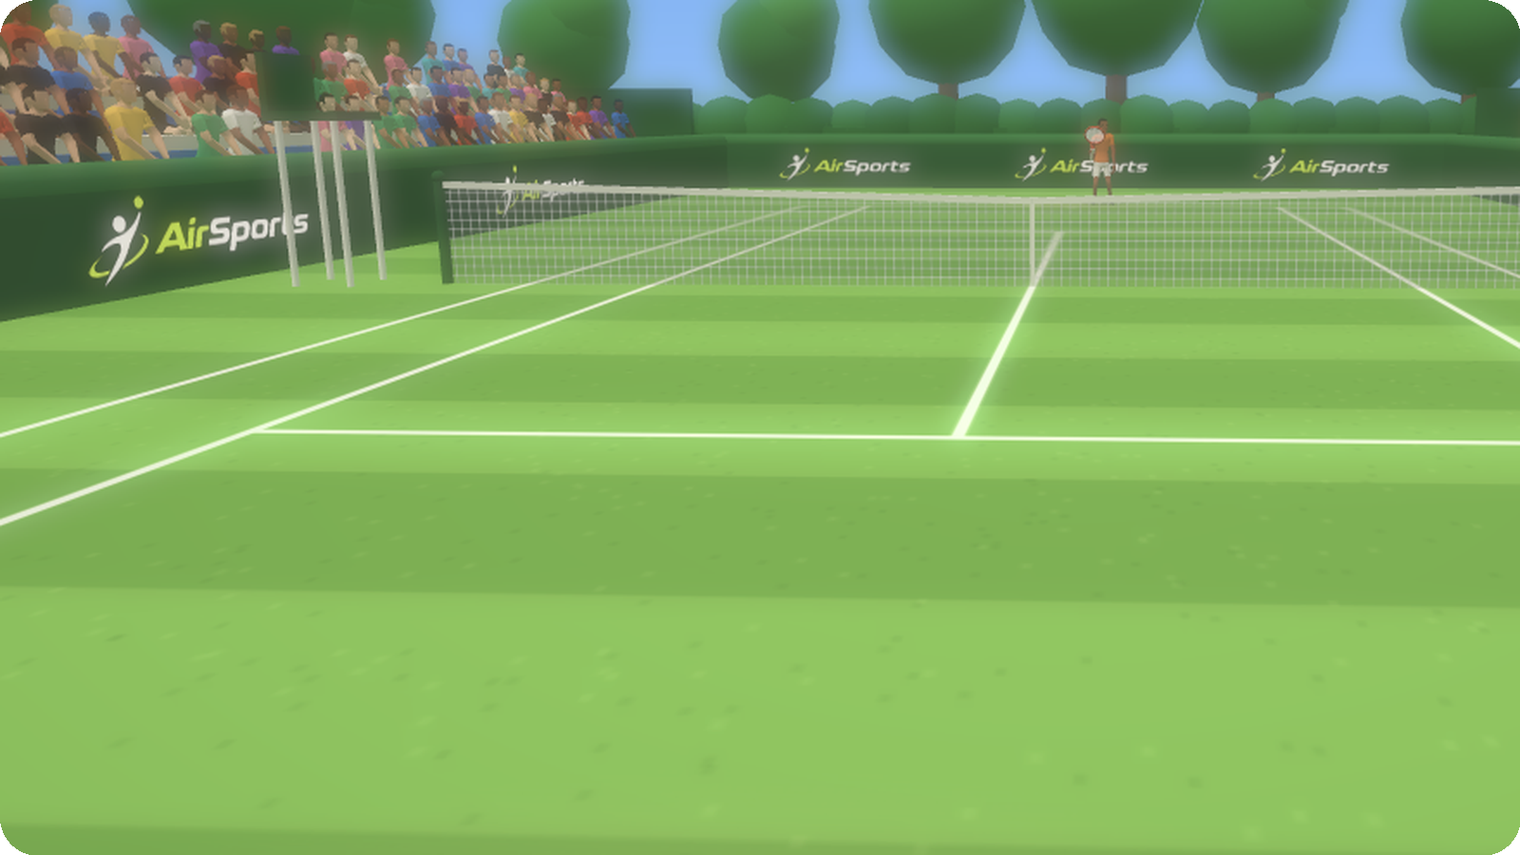
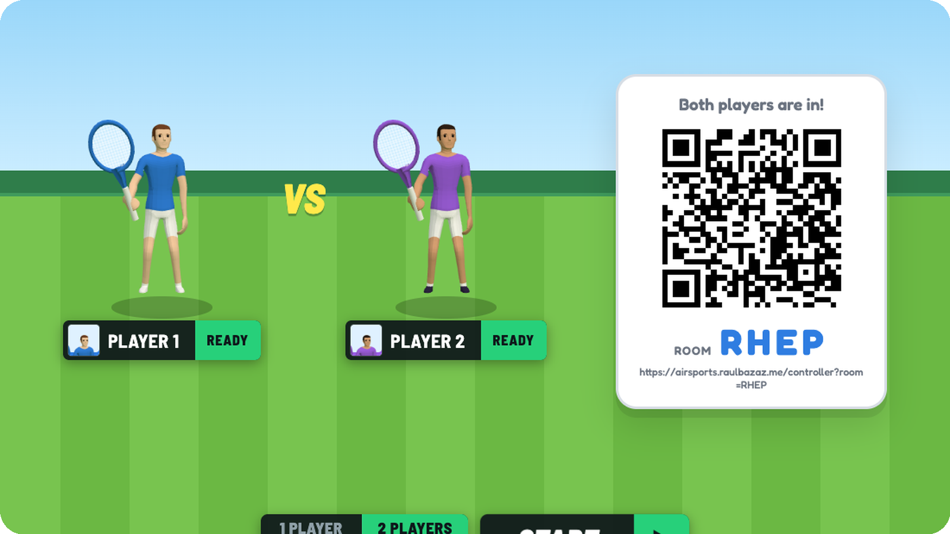
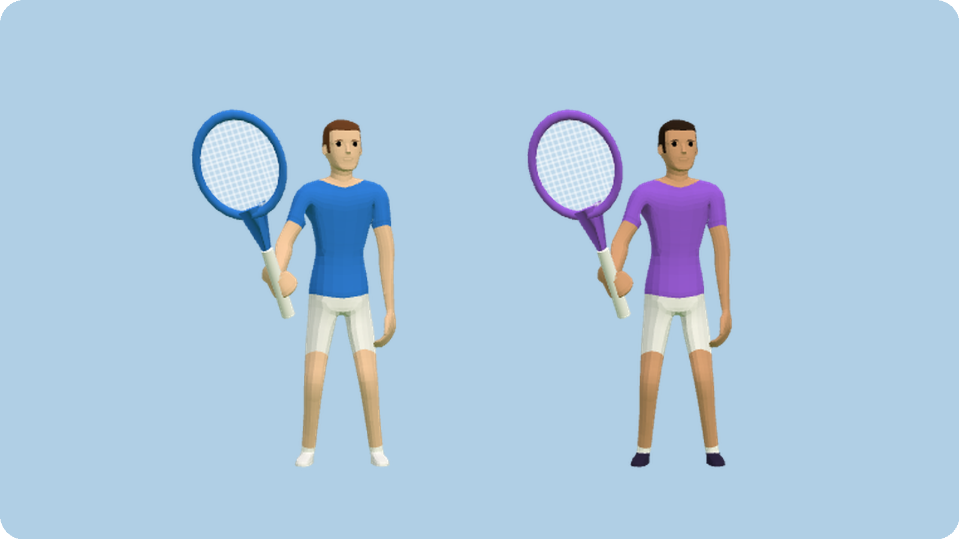
Business Model
Free to play, so anyone can try it in seconds. Revenue comes from where people play together.
Sponsored courts
Event packs
More sports
Brands buy the boards around the court, like a real stadium.
Paid tournament mode for college fests, cafes and offices.
Tennis stays free. Badminton, table tennis and more as paid packs.
Launch: college fests and hostels first, then cafes and offices.
Notes:
The court walls already carry the AirSports logo. Those exact boards can carry a sponsor's brand.

Slide 7
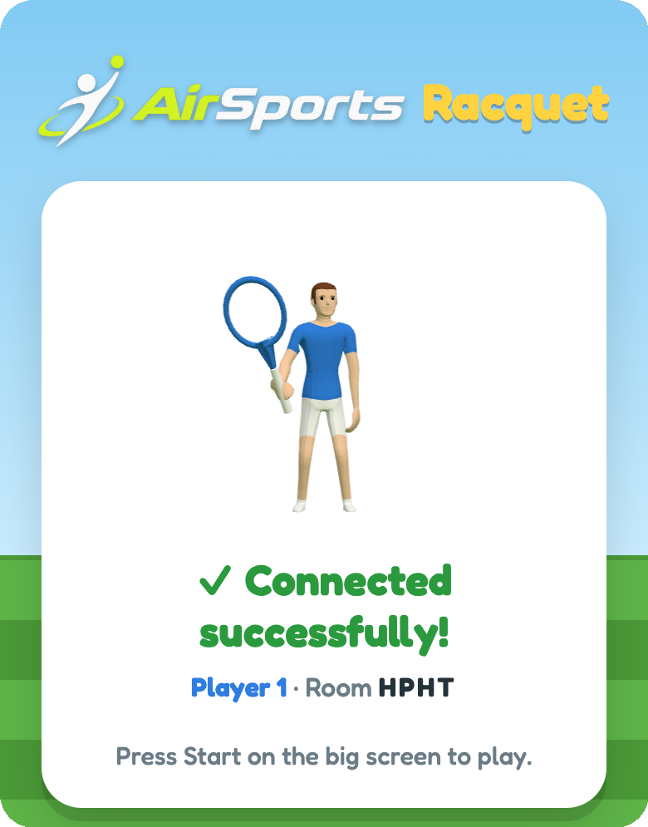

Market Adoption
People already love swinging at a screen.
Wii Sports sold about 82.9 million copies. The demand is proven; the hardware was the barrier.
Every phone in this room has the motion sensors AirSports needs.
Traction so far: [__ playtesters, __ matches played]
Scan and play now
Rollout
College fests
Hostels
Cafes
Offices
Notes:
Fill in the playtest numbers before presenting. Then invite a shark to scan the QR code and play.

Slide 8
Competition
How AirSports compares with motion games people know
 | AirSports | Switch Sports | Xbox Kinect | AirConsole
Extra hardware | None | Console + Joy-Cons | Xbox + Kinect | None
Setup | Scan a QR code | Buy the game | Buy and set up | Browser or app
Tracks a real swing | Yes | Yes | Yes (camera) | Mostly touch
Still sold | Yes, free | Yes | Discontinued | Yes
Where we're behind: phone sensors are less precise than Joy-Cons, we have one sport today, and we're a new name with no users yet.
Notes:
Be honest about the weaknesses; the sharks will ask. Our edge is zero hardware and zero install.

Slide 9



Our Team
Rahul Bajaj
Built so far
The 3D tennis game, the multiplayer server and the phone controller, all solo.
Looking for teammates
Someone for marketing and partnerships
A 3D artist for new sports and courts
A student project, built by one person.
Notes:
Add your photo in the circle. Say what you built yourself and who you'd like to work with.

Slide 10
Thank you
Scan to play: airsports.raulbazaz.me
Notes:
Leave this up during Q&A so people can scan and play.

